Slide 1
BEST LOCATION FOR INDIAN RESTAURANTS IN TORONTO
Coursera-capstone project
Neethu Muraleedharan

Slide 2
Introduction
While opening a restaurant can be a very lucrative business, a lack of demand or over saturation causes many restaurants to close within the first year of opening.
There are many different factors that can account for a restaurant’s success such as location, competition and quality of the food.
This is an important question that every business owner must face while choosing whether to open a restaurant or not? or which location is suitable for the business?

Slide 3
Business Problem
The objective of this project is to analyze and select the best locations in Toronto to open a new Indian restaurant.
Using data science methodology and machine learning techniques like clustering, this project aims to provide solutions to answer the business question: In the city of Toronto, if someone is looking to open a new Indian restaurant, where would you recommend that they open it?

Slide 4
Data acquisition and cleaning
Based on definition of our problem, factors that will influence our decision are:
Number of existing restaurants in the neighborhood (any type of restaurant)
Number of and distance to Indian restaurants in the neighborhood.
Distance of neighborhood from popular neighborhoods.
In our project we will:
Acquire the names and boroughs of the neighborhoods by scrapping a Wikipedia page.
Next, we use the foursquare API to find all types of restaurants within a 1000 meter radius for every neighborhood.

Slide 5
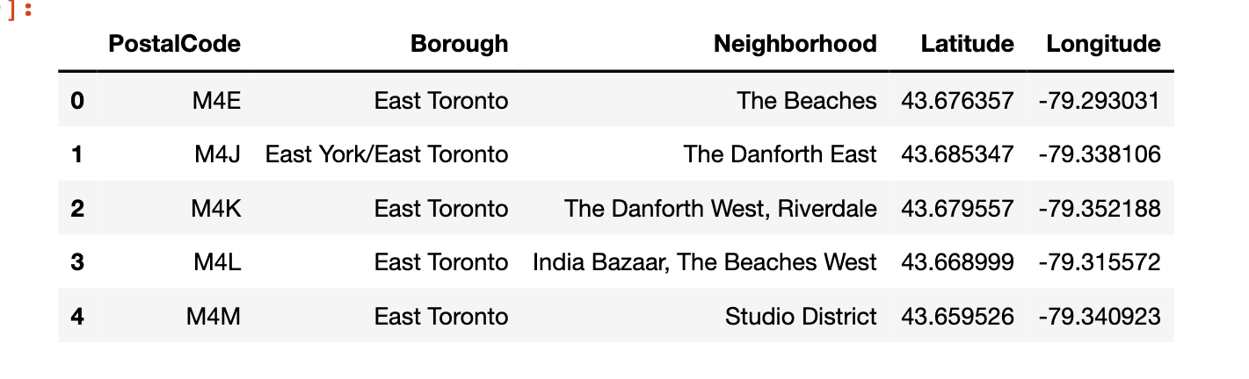
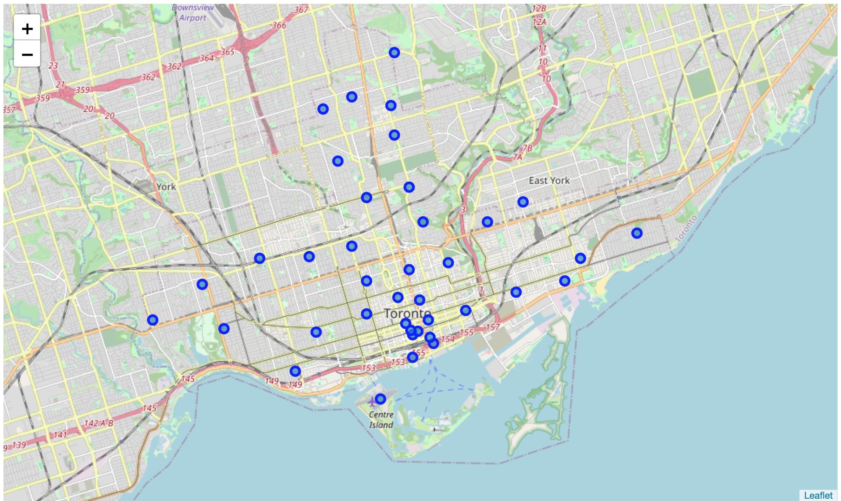
The latitude and the longitude coordinates of each neighborhood

Slide 6
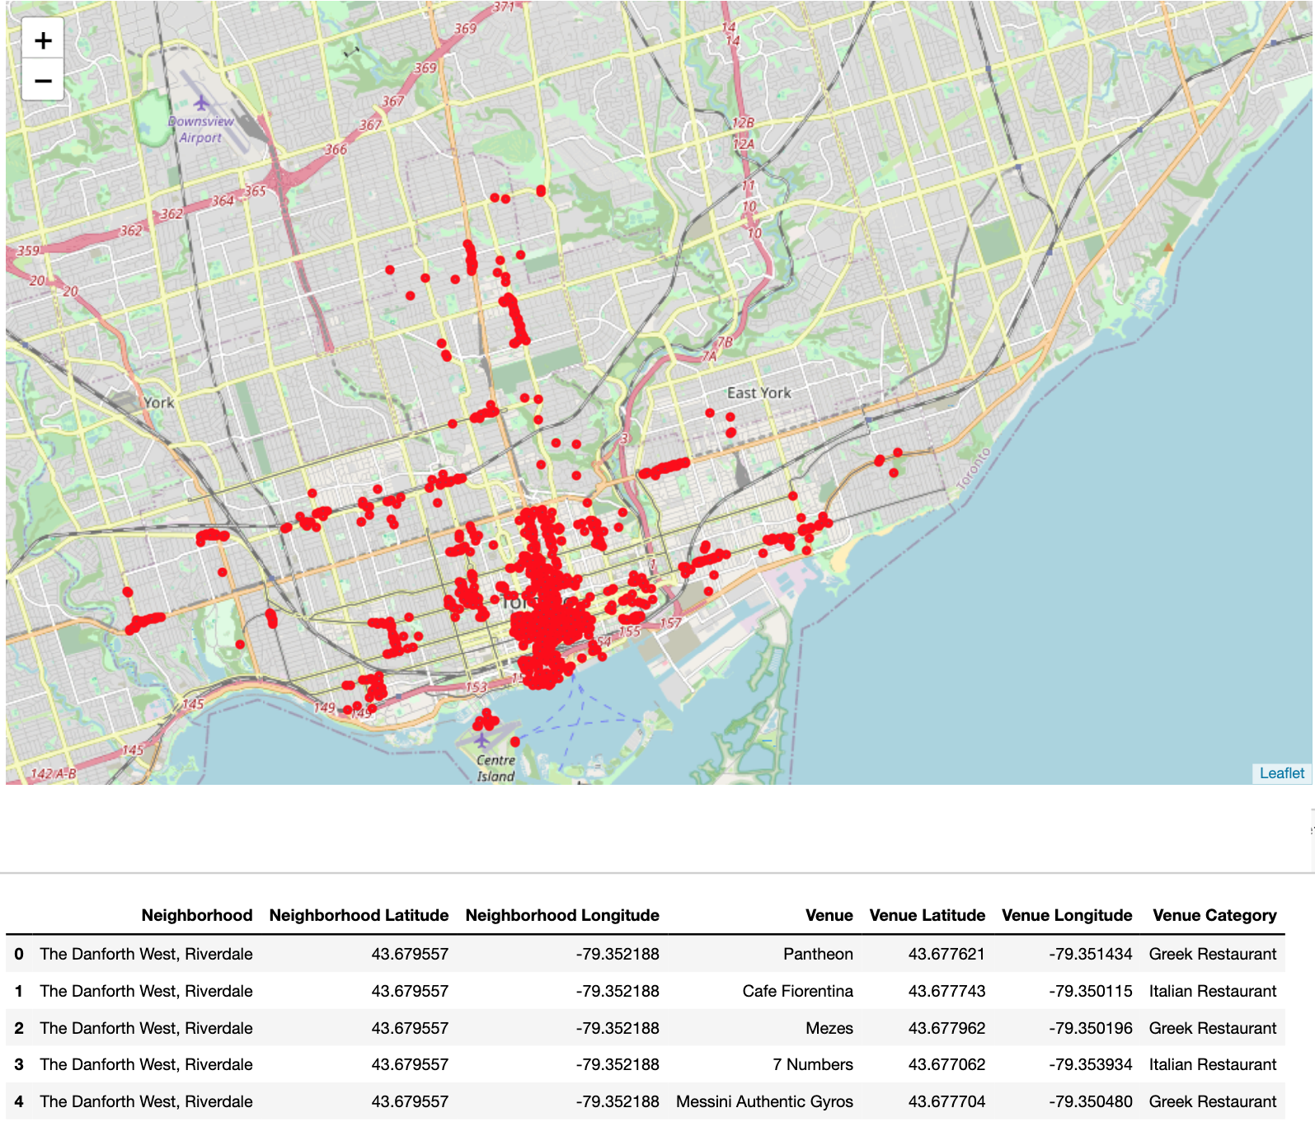
explore api call and filtering the search only to find venues that are identified as restaurants.

Slide 7
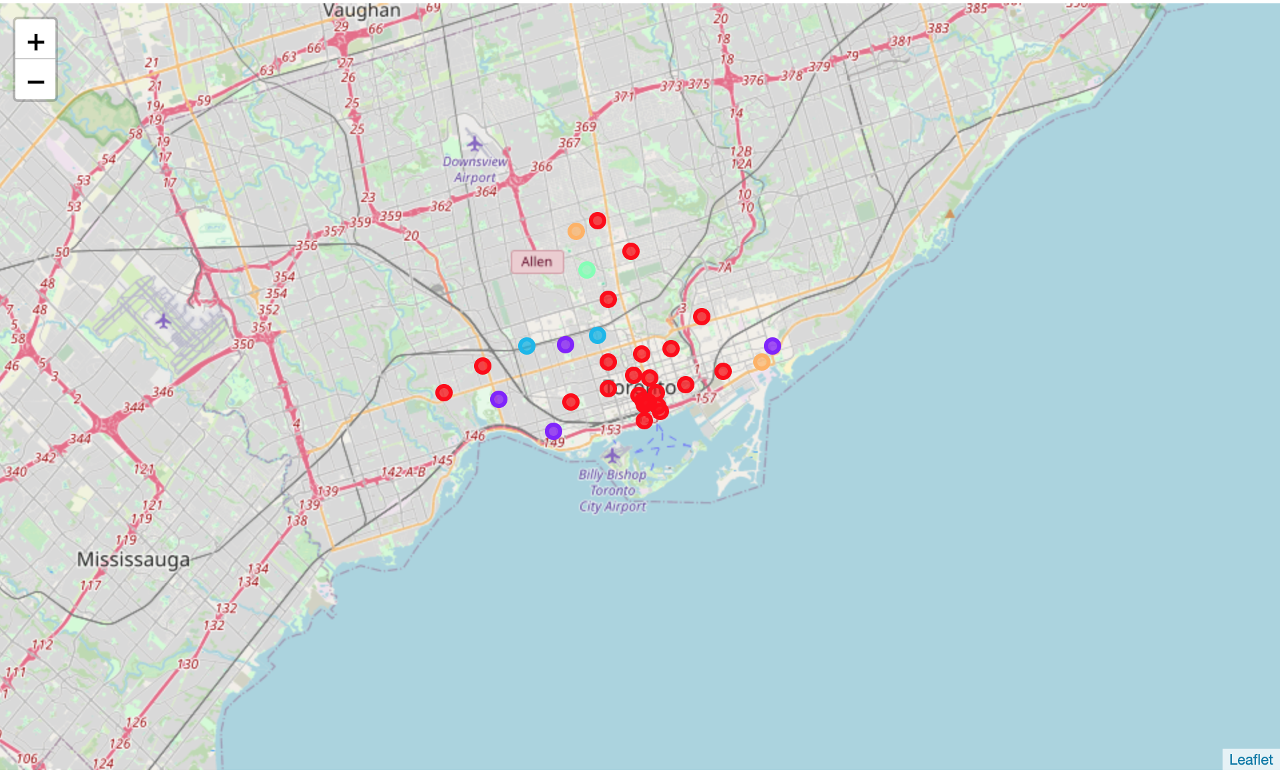
visualize the resulting clusters we will perform clustering on the data by using k-means clustering
CLUSTER 0 - RED
CLUSTER 1 - PURPLE
CLUSTER 2 - BLUE
CLUSTER 3 - TURQUOISE
CLUSTER 4 - ORANGE

Slide 8
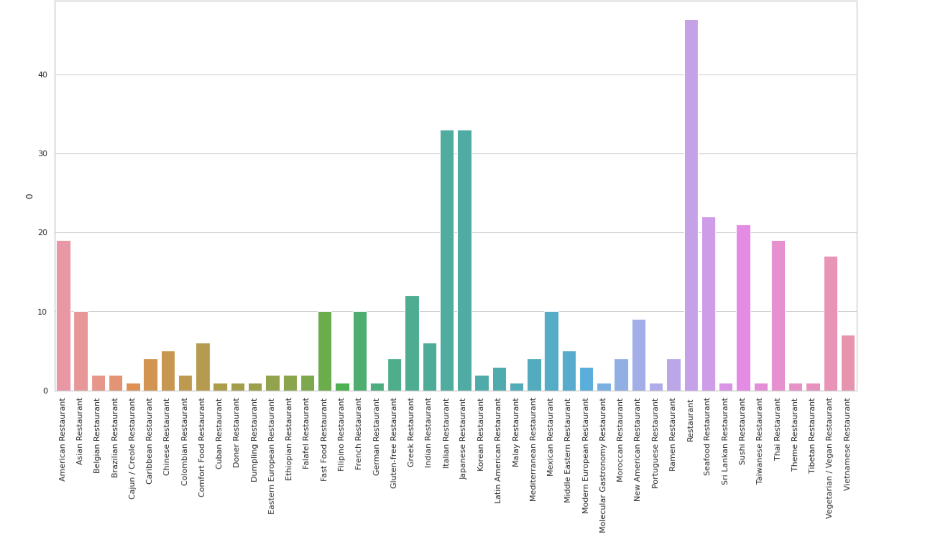
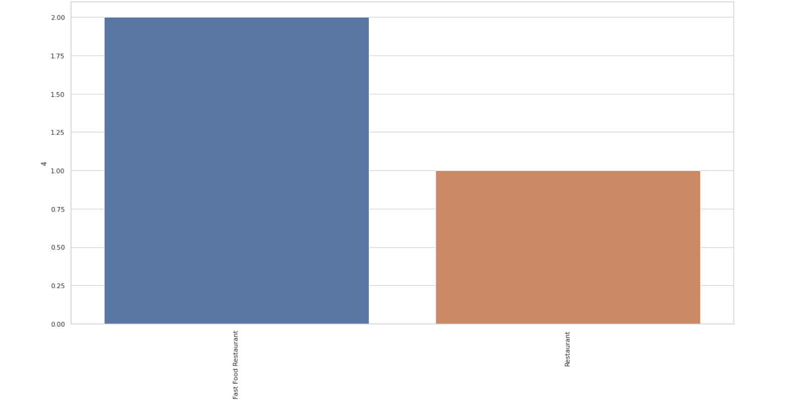
ANALYSING CLUSTERS

Slide 9
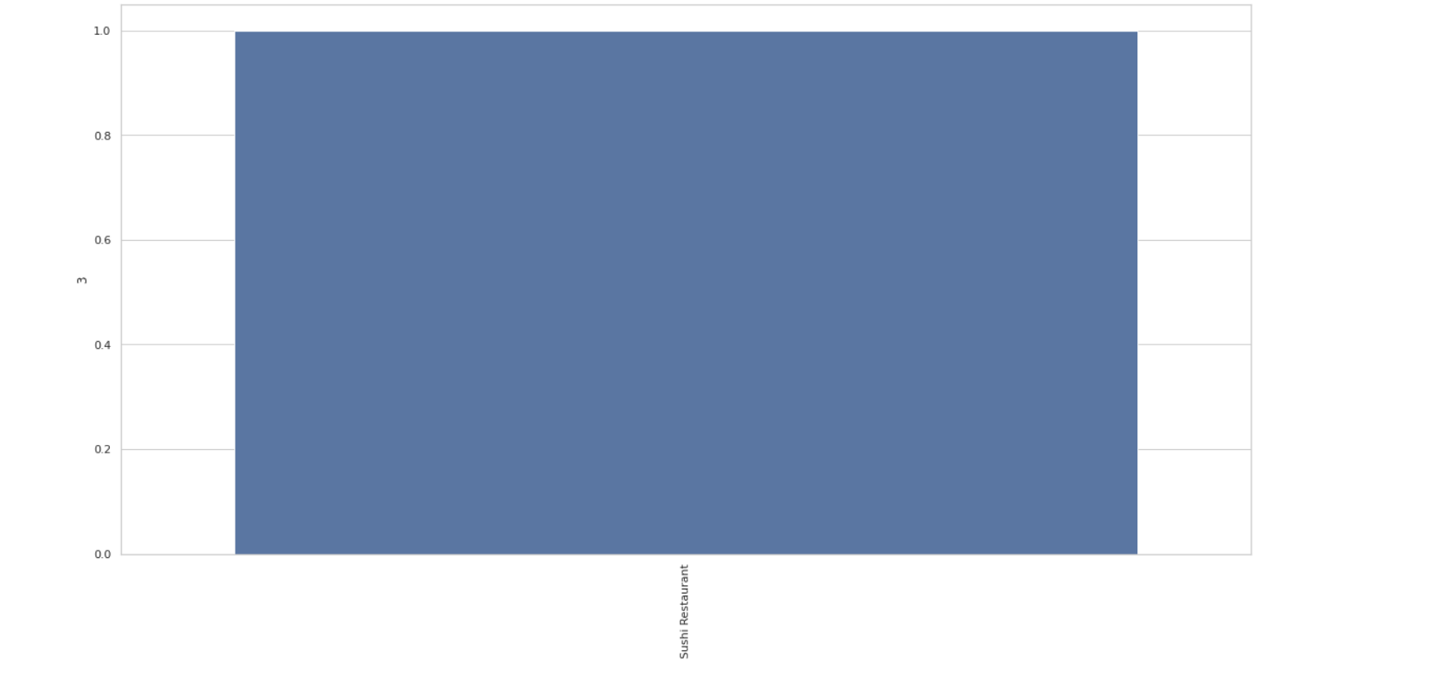
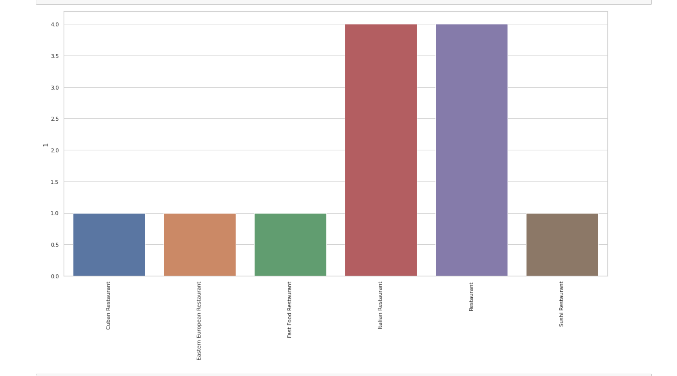
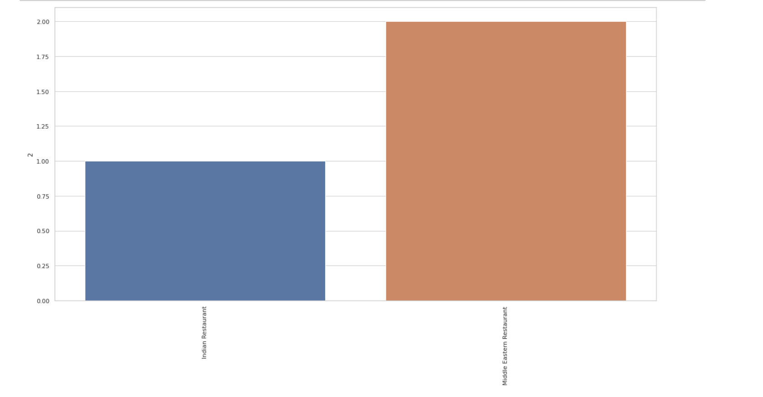

Slide 10
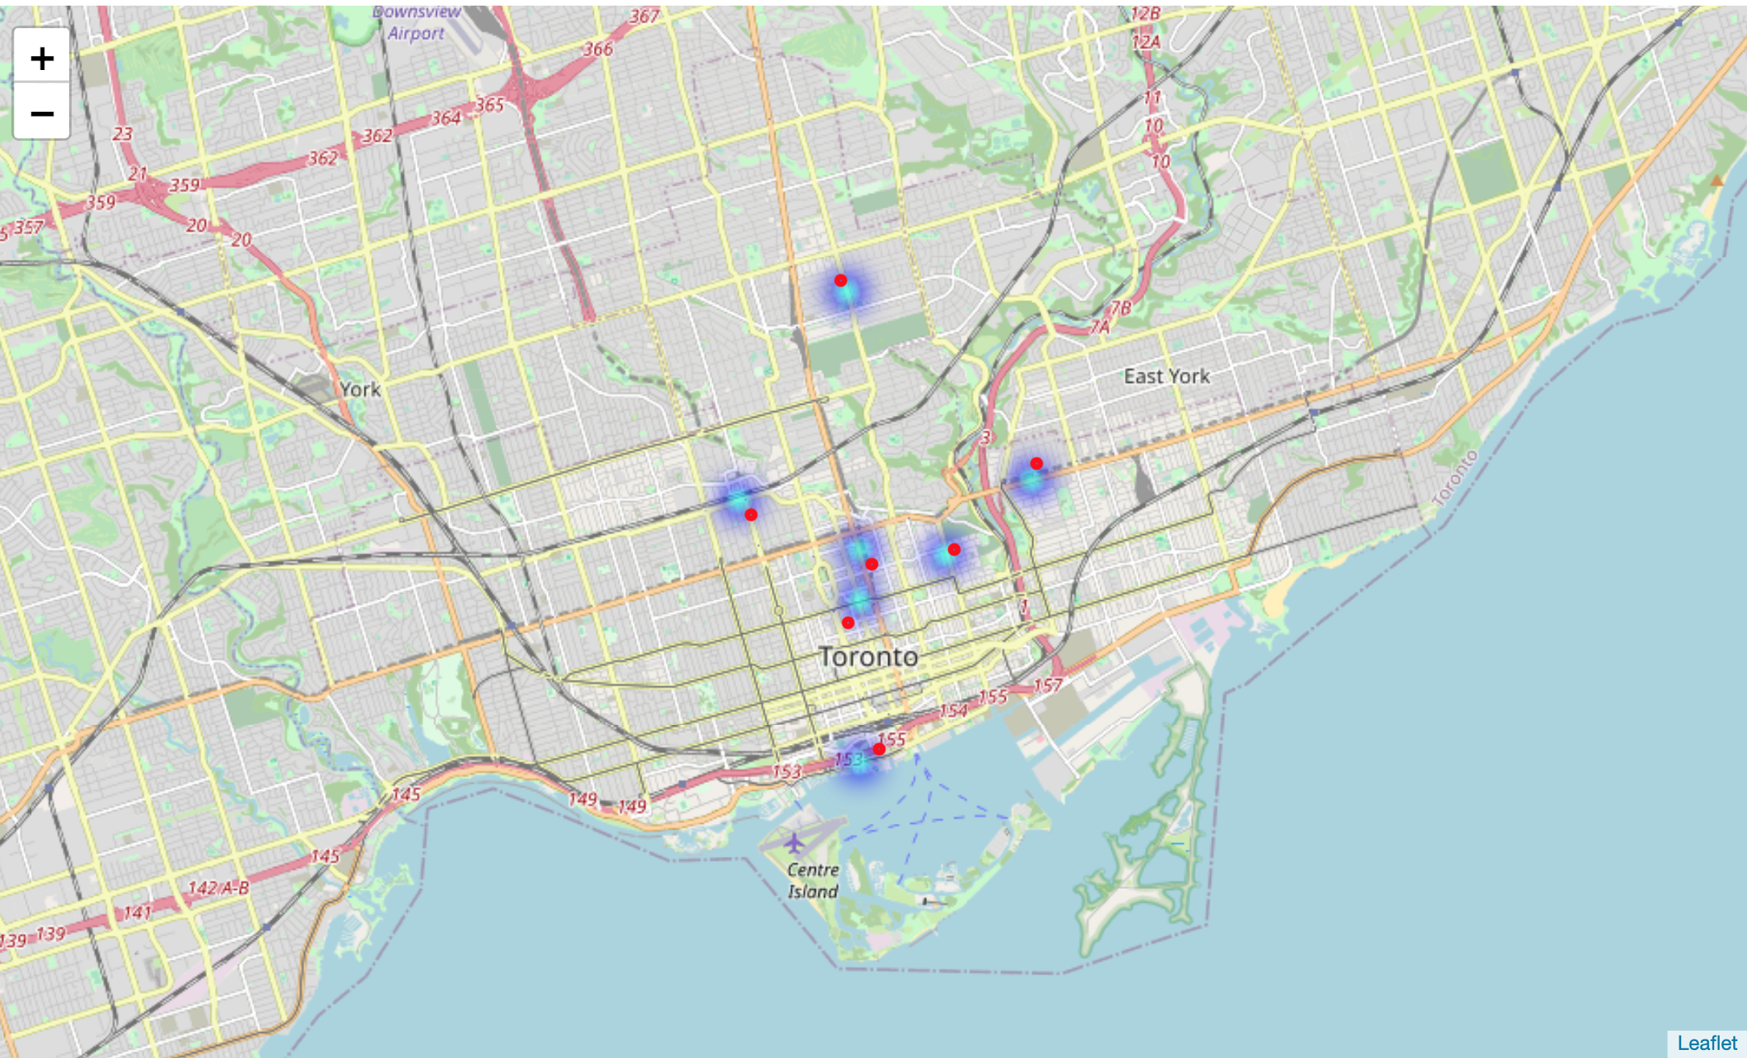
Analysing the bar graphs we can clearly see that clusters 0 and 2 have a high demand for Indian Restaurants

Slide 11
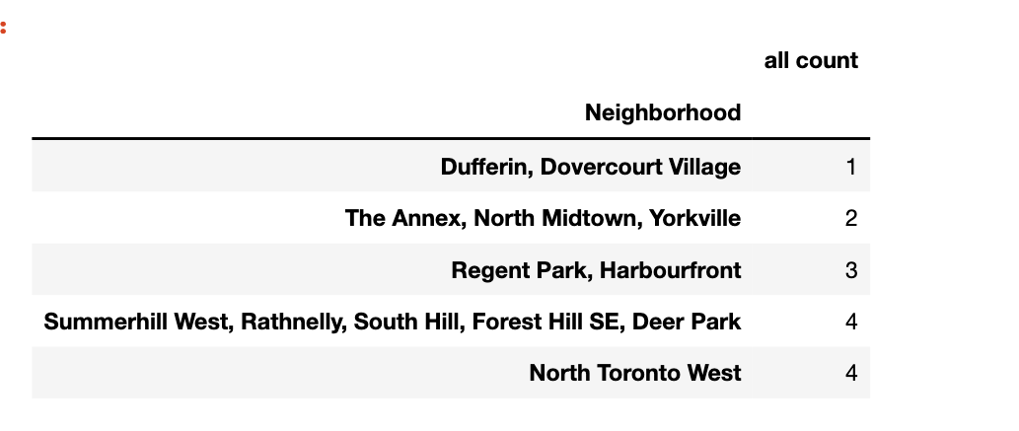
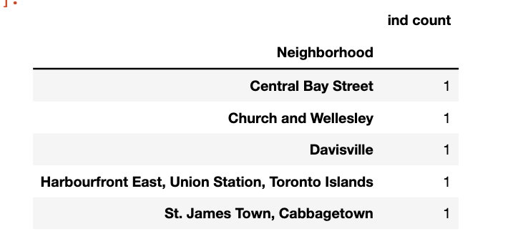
Removing all neighborhoods with the following conditions: Number of Indian restaurants >30% Number of all restaurants >60%

Slide 12
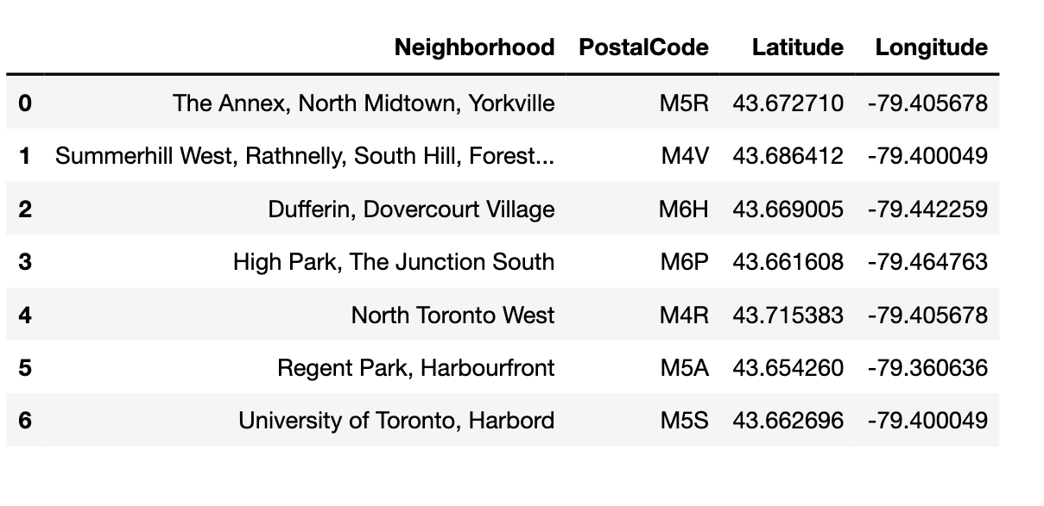
Taking the union of the resulting three dataset we get 6 neighborhoods that satisfy all three conditions laid out in the business problem by the customer.

Slide 13
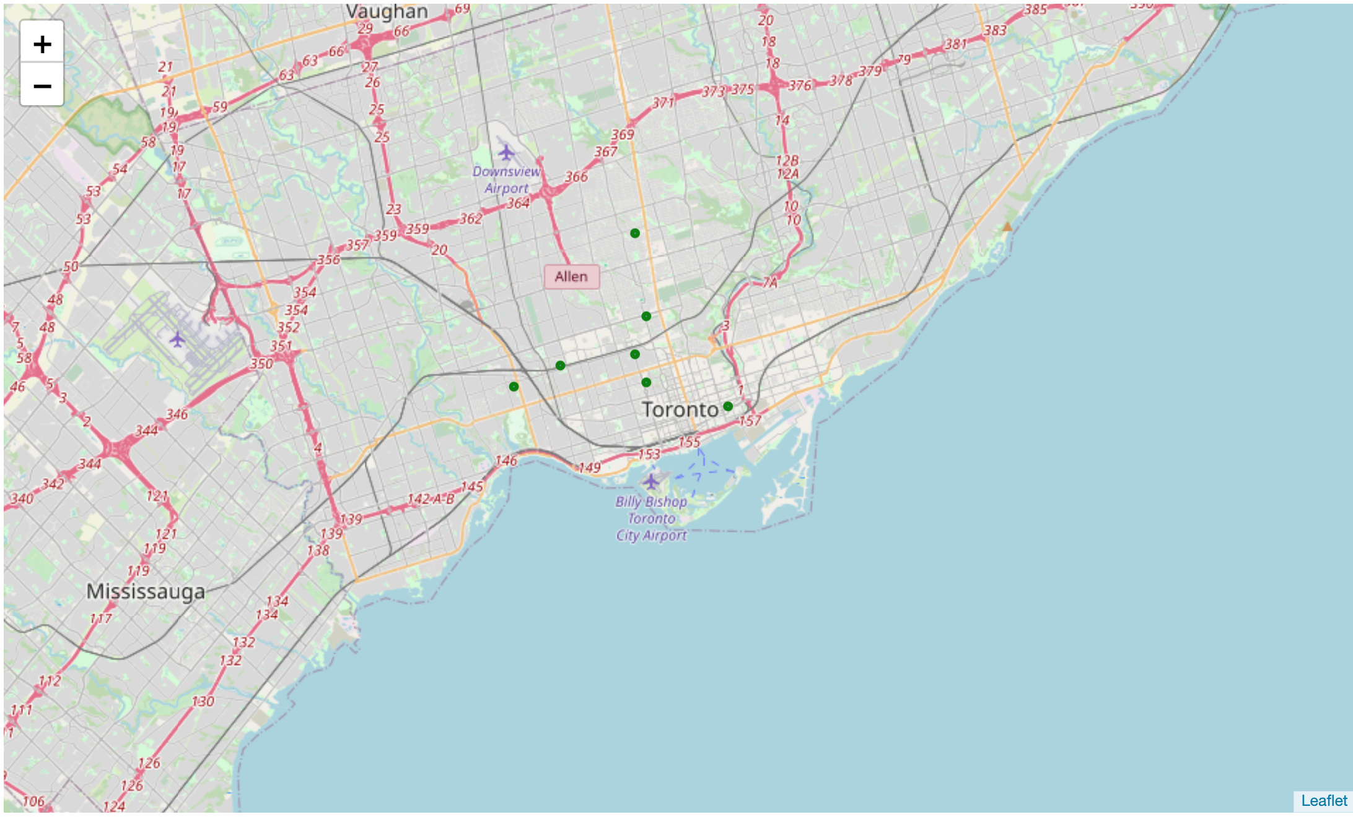
Conclusion
The neighborhoods recommendation obtained here are not completely accurate. This is due to the limitations in the dataset used in the project. Due to lack of cross referencing sources, we may have missed a few neighborhoods from our consideration.

Slide 14
THANK You!!

